Slide 1
Bluebonnet Learning Secondary Mathematics: Coach Student Work Analysis
Notes:
:01
Say: Welcome to our session for coaches of Bluebonnet Learning Secondary Mathematics! We will focus on Student Work Analysis in this session and how this work can support teachers implementing Bluebonnet Learning Secondary Mathematics.

Slide 2

Opening
We’re glad you’re here!
Please take out your copies of the:
Student Work Analysis Guided Notes
Student Work Analysis Protocol
Anchor lesson: Grade 8 Module 2 Topic 2 Lesson 2: Linear Relationships in Tables
Begin familiarizing yourself with the lesson by reading through all of the lesson components.
We will revisit this lesson later in this Session.
Notes:
:01-:02
Say: We’re so glad you’re here. As we’re getting settled, please pull up your guided notes and the anchor lesson.
Notes and Session Resources:
Participants may pull these resources up electronically or you could print them off for table groups depending on your delivery context.
Session Guided Notes Link:
Coach Student Work Analysis Protocol Link: https://drive.google.com/file/d/1qKfrOhDu9gNpLMpBPAVpaIUHVuVsHL3M/view?usp=sharing
Anchor Lesson Grade 8 Module 2 Topic 2 Lesson 2 Link: https://drive.google.com/file/d/1FXbpY7pvyGHVf50tO3dylFk8CM34Fldq/view?usp=sharing
Student Work Samples Link: https://drive.google.com/file/d/1ZzRQX8rpaqytUoLHuY33U6asMXrpq8zm/view?usp=sharing
Video for SWAP Step 2 Link: 7. SFI_SY25-26_BLMathSecondary_CSWA_Video_SWAPStep 2.mp4
Video for SWAP Step 3 Link:8. SFI_SY25-26_BLMathSecondary_CSWA_Video_SWAPStep3.mp4
Video for SWAP Step 4 Link:9. SFI_SY25-26_BLMathSecondary_CSWA_Video_SWAPStep4.mp4
Video for SWAP Step 5 Link: 10. SFI_SY25-26_BLMathSecondary_CSWA_Video_SWAPStep5.mp4

Slide 3
Facilitator Introduction
Facilitator Picture Here
Notes:
:03
Notes: If you’re facilitating the same group from a previous session, briefly re-introduce yourself. Share 2-3 bullets about your background, highlighting Texas/Bluebonnet Learning K-5 Math experience.

Slide 4




Norms for our Session
Engagement
Partnership
Curiosity
Grace
This work will support your students. Be an active participant in all learning experiences by sharing your thoughts and asking questions.
We are partners and our time is valuable. Please raise your hand and wait until others have finished their thoughts before you begin speaking.
We value your questions and will pause throughout our time together to answer questions.
Learning a new product for your subject can be challenging. You won't walk away today or even this year as experts. It's okay to walk away without a feeling of closure.
Notes:
:03
Say: Here are the norms I invite us to follow for each live session. We hope for these sessions to be filled with engagement, partnership, curiosity, and most importantly community. To ensure that we have sessions filled with these ideas, we’ve established these norms. First, please stay engaged and participate in all learning experiences. We also ask that you raise your hand to answer questions from the facilitator through the session.
Second, we want you all to feel as though you are partners in this work so if you have a question, please feel free to raise your hand. We want everyone to feel that what they think has value, so we ask that you wait for a person to finish their thoughts before speaking.
Third, please feel free to ask questions throughout our session.
Lastly, please give yourself grace and accept the lack of closure that will come from this learning journey. You won't know everything today, and that's okay. Be kind to yourself and others.
Facilitation Note:
This occurs after the HQIM Intro session so if you reviewed these norms in prior sessions, you may choose not to explain them again and instead highlight what you saw participants do well in the prior session and provide a focus area for your time together in this session
Optional edit: If you have a parking lot up for questions, you would want to name that with the curiosity norm.

Slide 5

Coach Session Objectives
During this session you will:
Understand how viewing student work is important to data-driven instruction
Explain the importance of each step of the Student Work Analysis Protocol
Lead the analysis of student work samples to identify student progress toward mastery and misconceptions
Notes:
:03
Summarize and/or have participants read the 3 bullets
Say: In this session, you will be introduced to the Student Work Analysis Protocol (SWAP) by reviewing each step while thinking through its impact. You will ground yourself in a formative assessment and what mastery of that assessment looks like. You will then use the success criteria you develop to sort student work samples and name trends using an asset-based mindset. Finally, you will use the data and trends you have identified to begin action planning.

Slide 6

Connecting to the Coaching Competencies​
Essential Questions:
How will the implementation of the Student Work Analysis Protocol be similar to how you have responded to data in the past? How will be different?
What are the benefits of using the Student Work Analysis Protocol in planning and supporting student learning?
Aligned Competency:
Coaching Competency 2:
Establish effective collaborative planning practices that align with the local context and lead effective teacher collaborative planning sessions focused on effective HQIM practices using high-leverage protocols
Based on the overview, objectives, and essential question, how do you think the Student Work Analysis (SWAP) Session will contribute to mastery of Competency #2?​
Take 1 minute to record your response in your guided notes.
Notes:
:03-:05
Say: Before we dive into our session, we are going to set our purpose for learning and connect to the competencies we are building as part of this pilot. Have a participant read the essential question and another participant read the aligned competency. Now that we have named the purpose of our learning today, take a moment to reflect on how this session will contribute to the mastery of the aligned competency. Jot this down in your guided notes. If time allows, you could have participants share their thoughts with a partner.

Slide 7
Agenda - Student Work Analysis Protocol and Steps 1-3
Introduction
Student Work Analysis Protocol and Steps 1-3
Steps 4-6
Closing
Notes:
:05
5 min mark

Slide 8
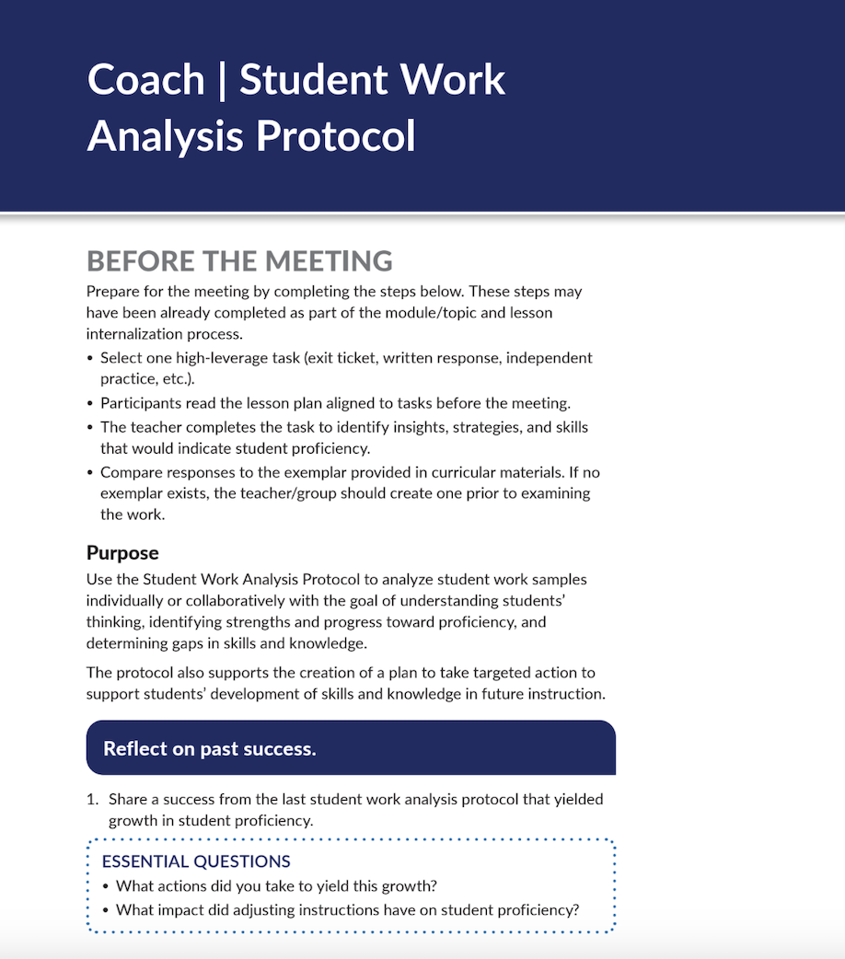

SWAP Deep Dive
Directions:
Take 5 minutes to open and read the Student Work Analysis Protocol Coach Guide
While reading, you may use your guided notes to record your thoughts, then be ready to share.
Consider and be ready to share:
How is this protocol similar to the ways that you are already responding to student work?
What are some ways that you can incorporate this work in your collaborative meetings with teachers?
Notes:
:05-:12
Say: In this session, you will thoroughly review each step of the Student Work Analysis Protocol and learn how to guide all teachers through regular cycles of student work analysis.​ Additionally, as you and your teachers begin to deeply analyze student work, keep in mind that in Bilingual and Dual Language classrooms, it is important to analyze student work through a “holistic approach.” In other words, consider students’ strengths in both languages—what can students do in one language to help support what they cannot do YET in the partner language. ​
​To prepare yourself to use the Student Work Analysis tool, take a moment to read through the protocol in its entirety.​​ Give participants 5 minutes to read the SWAP Teacher Guide. After time is up, you can call on participants to share. Today we will be looking at the Talk the Talk DEMONSTRATE from Grade 8 Module 2 Topic 2 Lesson 2 focusing on Questions 1-4. These problem capture the skills and knowledge students were expected to gain throughout the lesson to make progress towards meeting the objective.
Resources:
Coach Student Work Analysis Protocol Link: https://drive.google.com/file/d/1qKfrOhDu9gNpLMpBPAVpaIUHVuVsHL3M/view?usp=sharing
Anchor Lesson Grade 8 Module 2 Topic 2 Lesson 2 Link: https://drive.google.com/file/d/1FXbpY7pvyGHVf50tO3dylFk8CM34Fldq/view?usp=sharing

Slide 9
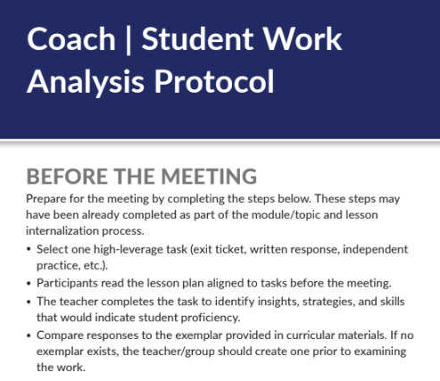
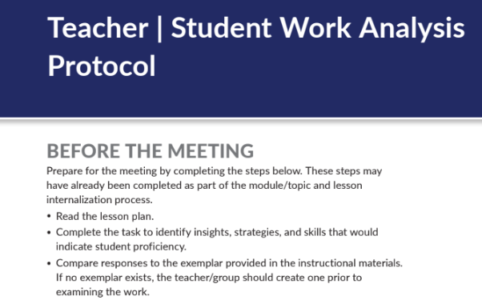
Before the Meeting
Notes:
animated slide
:12-:13
Say: Before launching into the first step of the SWAP Coach Guide, let’s look over the “Before the Meeting” portion of the SWAP. We are going to compare it to the Teacher SWAP to determine how, we as coaches, should prepare our teachers. Notice that most of the steps are the same. However, as a coach, you will want to select the high-leverage tasks that best supports the objective for the lesson. Feel free to get input from your teachers on this selection. However, it needs to be selected before the meeting so that the teachers can come to the meeting prepared having read the lesson, completed the high-leverage task as a student would and compared responses with the exemplar provided detailing insights, strategies and skills that indicate student proficiency.
Some of those steps may have already occurred in the Module/Topic or Lesson Internalizations! If so that means that the coach has great systems and structures for accountability and teachers will be prepared to engage in the meeting. Consider what systems and structures could set teachers up for success to come prepared to analyze student data.

Slide 10
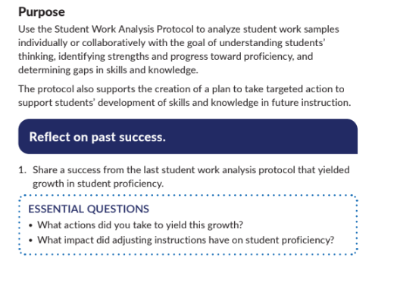
Purpose and Reflection
Notes:
animated slide
:12-:13
Say: Before launching into the first step of the SWAP Coach Guide, I want to highlight the purpose of the protocol. You’ll want to make sure to provide a clear “WHY” behind the process of analyzing student work. It will set the stage for collaboration and will support engagement from teachers.
If you have already engaged in a round of SWA, you’ll have your teachers reflect on their past experiences with student data and growth. The first time you use the protocol, this step may not seem necessary—since no prior experience with it can be leveraged. However, during this initial cycle, it is still wise to begin by asking your teachers to consider how any prior efforts at looking at and responding to trends in student work have had a positive impact on instruction and student outcomes. In subsequent cycles with the SWAP, you can then reflect on prior use of the protocol itself. Starting with reflection helps to ensure that we bring an asset-based approach to this work—harnessing what has gone well in the past with the SWAP to build teachers’ motivation for ongoing use of it.

Slide 11
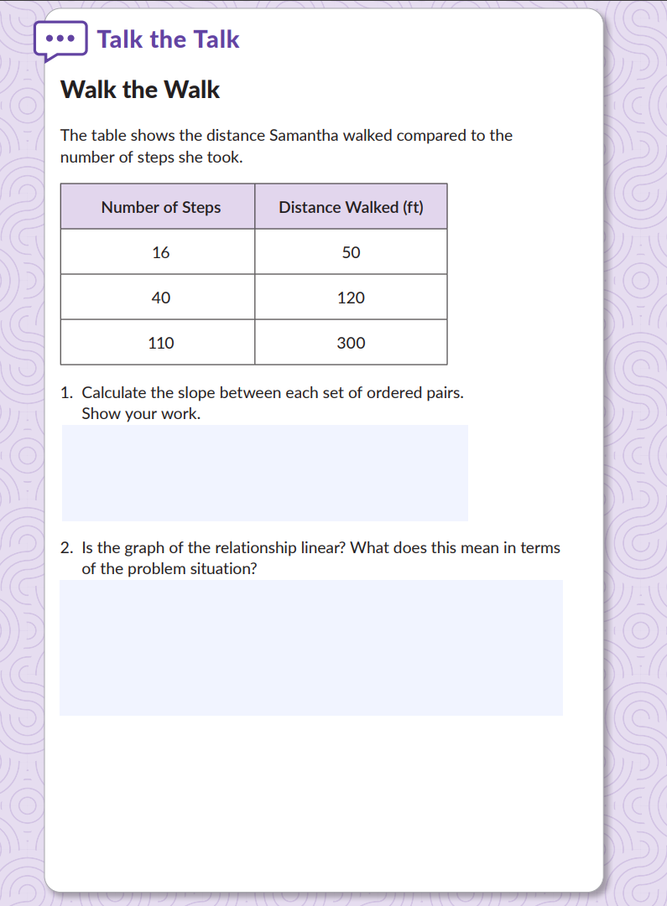
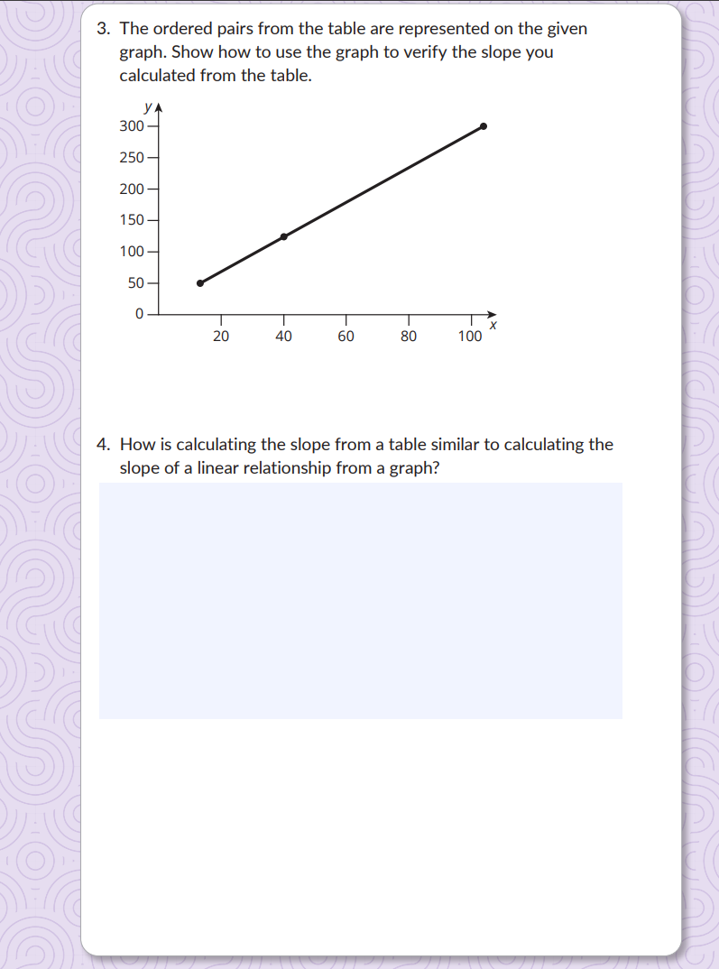
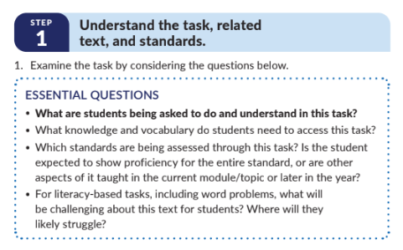
Step 1: Understand the task, related text and standards
Directions:
Take out Grade 8 Module 2 Topic 2 Lesson 2: Linear Relationships in Tables from Bluebonnet Learning Secondary Mathematics.
Read the lesson then focus on Talk the Talk Problems 1-4.
Consider and be ready to share:
What are students being asked to do and understand in this task?
What knowledge, skills, and vocabulary do students need to access this task?
Which standards are being assessed through this task?
What will be challenging about this task for students?
Notes:
:13-:20
Say: In Step 1, teachers and coaches are asked to review a task and determine what specifically is being asked of students. Doing this will help to better understand how students’ pre-existing strengths will be essential. This will also support anticipating potential misconceptions.​
Let’s open the Grade 8 Module 2 Topic 2 Lesson 2 from Bluebonnet Learning Secondary Mathematics. Skim the lesson and read the Talk the Talk task. As you read the task, consider the following questions: What are students being asked to do and understand in this task? What knowledge, skills, and vocabulary do students need to access this task? Which standards are being assessed through this task? What will be challenging about this task for students?​ 5 min to read the lesson/task and consider the questions, 3 min to share
Notes and Resources:
Though not a requirement of the step, it is recommended to complete the tasks in order to create a deeper level of understanding of the thinking students are being asked to do.​
Anchor Lesson Grade 8 Module 2 Topic 2 Lesson 2 Link: https://drive.google.com/file/d/1FXbpY7pvyGHVf50tO3dylFk8CM34Fldq/view?usp=sharing
​

Slide 12
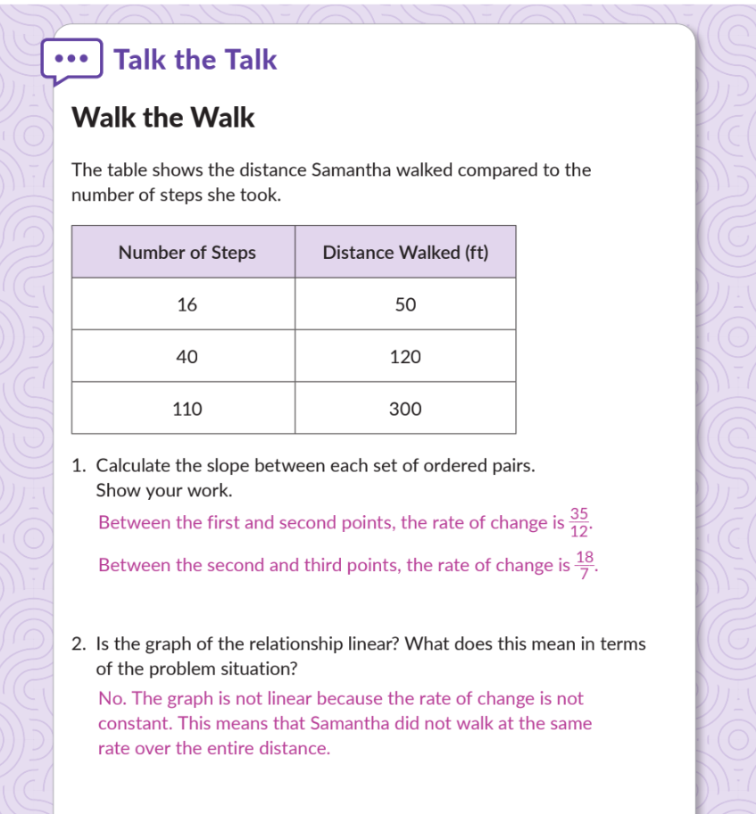
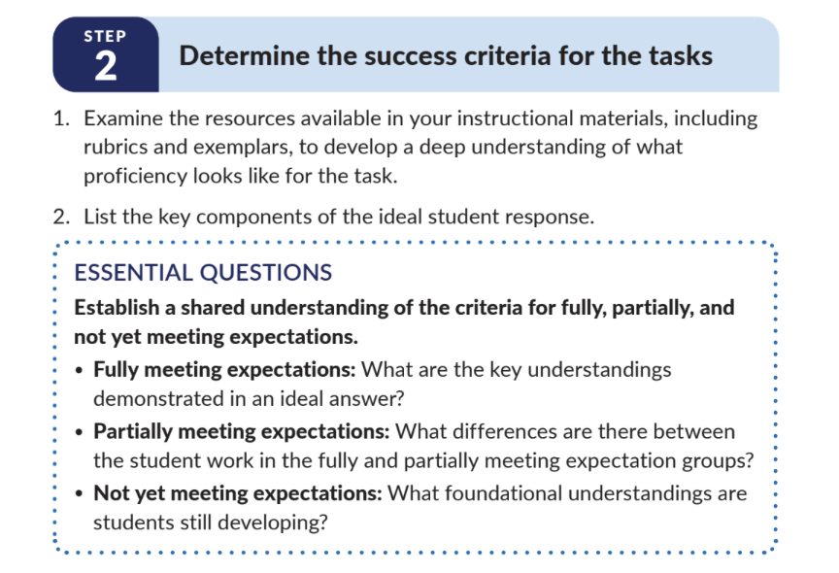
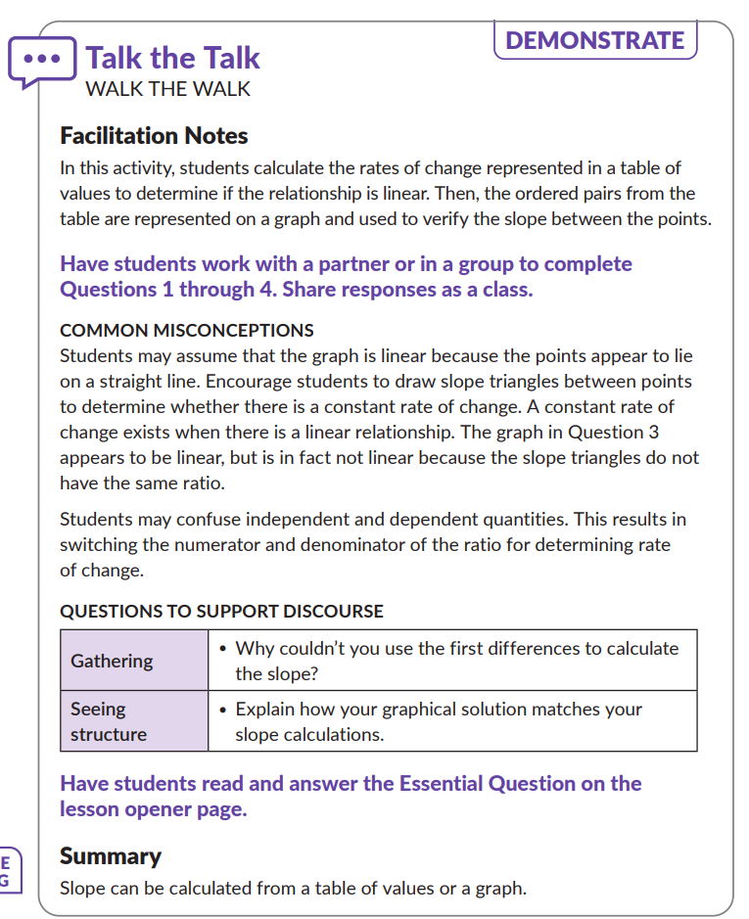
Step 2: Determine the Success Criteria for the Tasks
Notes:
:20-:21
Say: Let’s dive into step 2. ​Have a volunteer to read step 2​ In this step, we’re going to establish a shared understanding of what proficiency looks like for Talk the Talk problems 1-4, which asks students to calculate slope based on a set of ordered pairs and determine if the graph of the relationship is linear. It then asks students to show how to use a graph to verify the slope from the ordered pairs is linear and compare the calculations from the table to the graph.
To begin, please take 1–2 minutes to quietly review the facilitation notes, common misconceptions, questions to support discourse and the answer key. While reviewing, ask yourself: What are the criteria for an ideal student response? How does the work in the 4 questions align with the learning targets and standards for this module?
As a coach, use the following to guidance and deepen the team’s understanding:
“What specific part of the exemplar shows a deep understanding of the problem?”
“Let’s connect this back to the module learning goals—how does this response show readiness for what’s coming next?”
“How might we use this criteria to sort and make sense of our own students’ responses in the next step?”
Encourage your team to capture the success criteria on a visible anchor chart or shared doc so that it can guide sorting in Step 3 and future instructional decisions.

Slide 13
Step 2: Determine the Success Criteria
Directions:
Review your reflections from Step 1.
Take 4 min and create a list of 3-4 success criteria for the task.
Consider and be ready to share:
What does it look like for a student to be fully meeting these expectations?
What does it look like for a student to be partially meeting these expectations?
What does it look like for a student to not yet be meeting these expectations?
Strong Success Criteria
Are observable in student’s responses
List the qualities that must be present in the student’s response
Use student friendly language
Align to the objective and exemplar response
Exit Ticket #3 WRITE THIS DOWN Strong success criteria 1) are observable in the student’s response, 2) List the qualities that must be present in the response, 3) Use student—friendly language, and 4) Align to the objective. Choice 1 is not observable as there is no way to know from the work sample alone how much time was spent on the task.​
Notes:
:21-:27
Say: Now that you’ve looked at the task in detail and considered ideal student responses, let’s determine the success criteria for this problem. Strong success criteria are: observable in student’s responses, list the qualities that must be present in the student’s response, use student-friendly language, and align to the objective and exemplar response. ​ In creating these success criteria, you will have a clear picture of what it means for a student to be fully, partially, or not yet meeting expectations.​ You are now going to practice creating a list of success criteria and reflect on what it looks like for students to be fully, partially, or not yet meeting expectations for the Grade 8 Module 2 Topic 2 Lesson 2: Linear Relationships in Tables Talk the Talk task . 4 minutes: create success criteria list, 2 minutes: share with partner

Slide 14
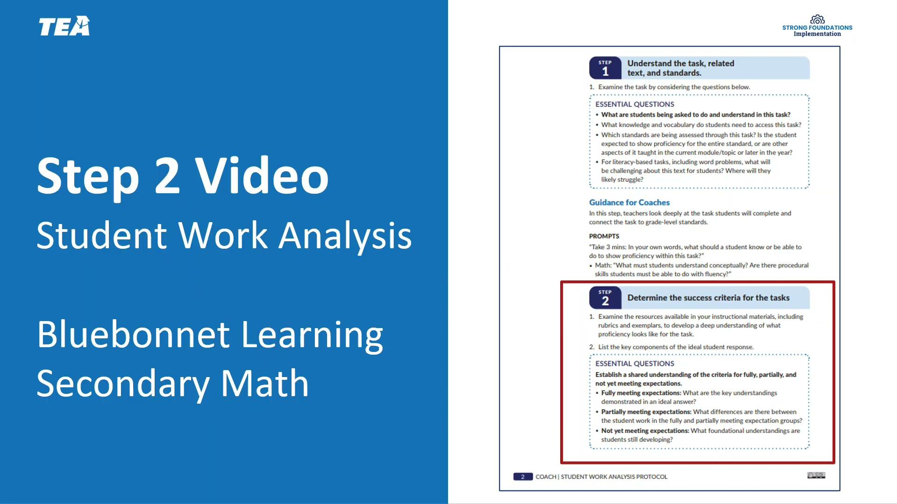
Notes:
Video for SWAP Step 2 Link: 7. SFI_SY25-26_BLMathSecondary_CSWA_Video_SWAPStep 2.mp4

Slide 15
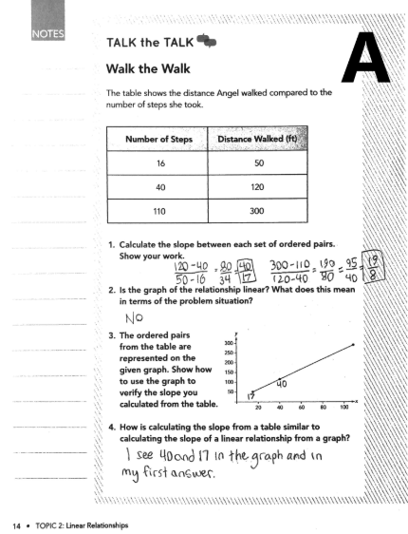
Step 3: Analyze and Sort Student Work
Directions:
Read through the Student Work Samples
Then, sort them into the correct category.
Fully Meeting Expectations
Partially Meeting Expectations
Not Yet Meeting Expectations
Student D
Student B
Student A
Student E
Student F
Student C
Notes:
animated slide
:27-35
Say: Once the success criteria have been determined and an understanding of fully, partially, and not yet meeting expectations is established, the next step is to sort student work into the three categories. You will practice this now for 3 min using samples from the Talk the Talk with your table groups.
Notes and Resources:
Student work Samples Link: https://drive.google.com/file/d/12WNZ4Cu92HxIMUfLKNv1TAe_rBjE9eyv/view These are from previous SFI learning however, the task and questions are the same. Updated Student work samples will be available on by June 20th.
You can either print the work samples and give a set to each table or create a bitly/padlet that will take participants to a soft copy of the student work samples.
You will share the correct sorting with participants and talk through each sample. In the next slide, participants will be able to compare their work with one sample of each category with a Bluebonnet Learning Secondary Math Coach.
Answers are as follows- Fully meeting expectations: Student D and E , Partially meeting expectations: Student B and F , Not Yet meeting expectations: Student A and C

Slide 16
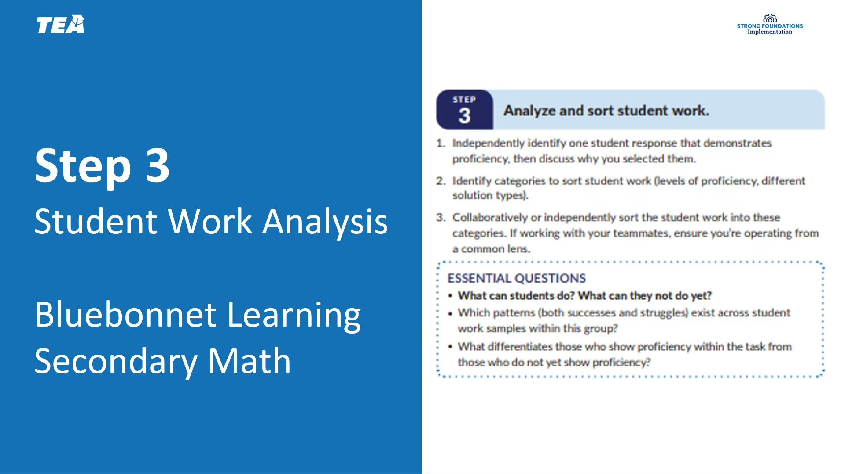
Notes:
Video for SWAP Step 3 Link:8. SFI_SY25-26_BLMathSecondary_CSWA_Video_SWAPStep3.mp4

Slide 17
Agenda - Steps 4-6
Introduction
Exit Ticket #1: WRITE THIS DOWN
Answer Rationale: While several of these answer choices are related to the SWAP, at least in part, the real impact is the impact on students who will be receiving instruction that accelerates their learning in a way that is specific to their strengths and areas of growth.
Student Work Analysis Protocol and Steps 1-3
Steps 4-6
Closing
Notes:
:35
35 min mark

Slide 18
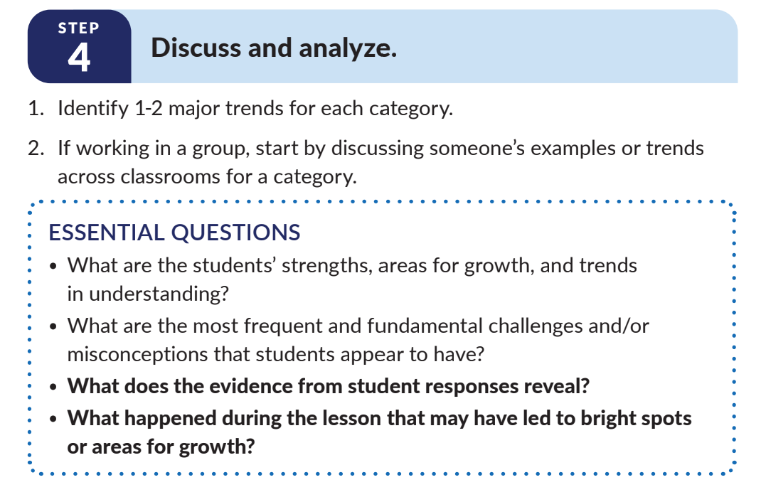
Step 4
  Targeted Skill: Discussion and analysis using an asset-based mindset.
  Guiding Question:
What is the impact on student learning when using an asset-based mindset (as opposed to a deficit-based mindset) in this step?
Notes:
:35-:40
Say: In Step 4, you will review the student work samples they have already sorted to identify trends that span across each particular level, as well as across the class as a whole. When completing this step, it is essential to do so using an asset-based mindset. Look first for what students can do before considering what they cannot do yet. This step is all about making meaning of the patterns we’ve uncovered and identifying trends in student understanding—both strengths and misconceptions. Using the student work samples, identify 1-2 major trends consider the essential questions. Give participants 5 minutes to look at trends and discuss in partners or table groups.
Coaches can use the following prompts to guide deeper analysis:
“What are key strengths in students’ understanding of systems of equations?”
“What are the most frequent or fundamental misunderstandings?”
“Did any instructional decisions help illuminate or hinder understanding?”
Encourage teachers to make notes under each proficiency group so that these observations are easily referenced when you move to Step 5.
Notes:
For extension, have a discussion grounded in the question on the slide.

Slide 19
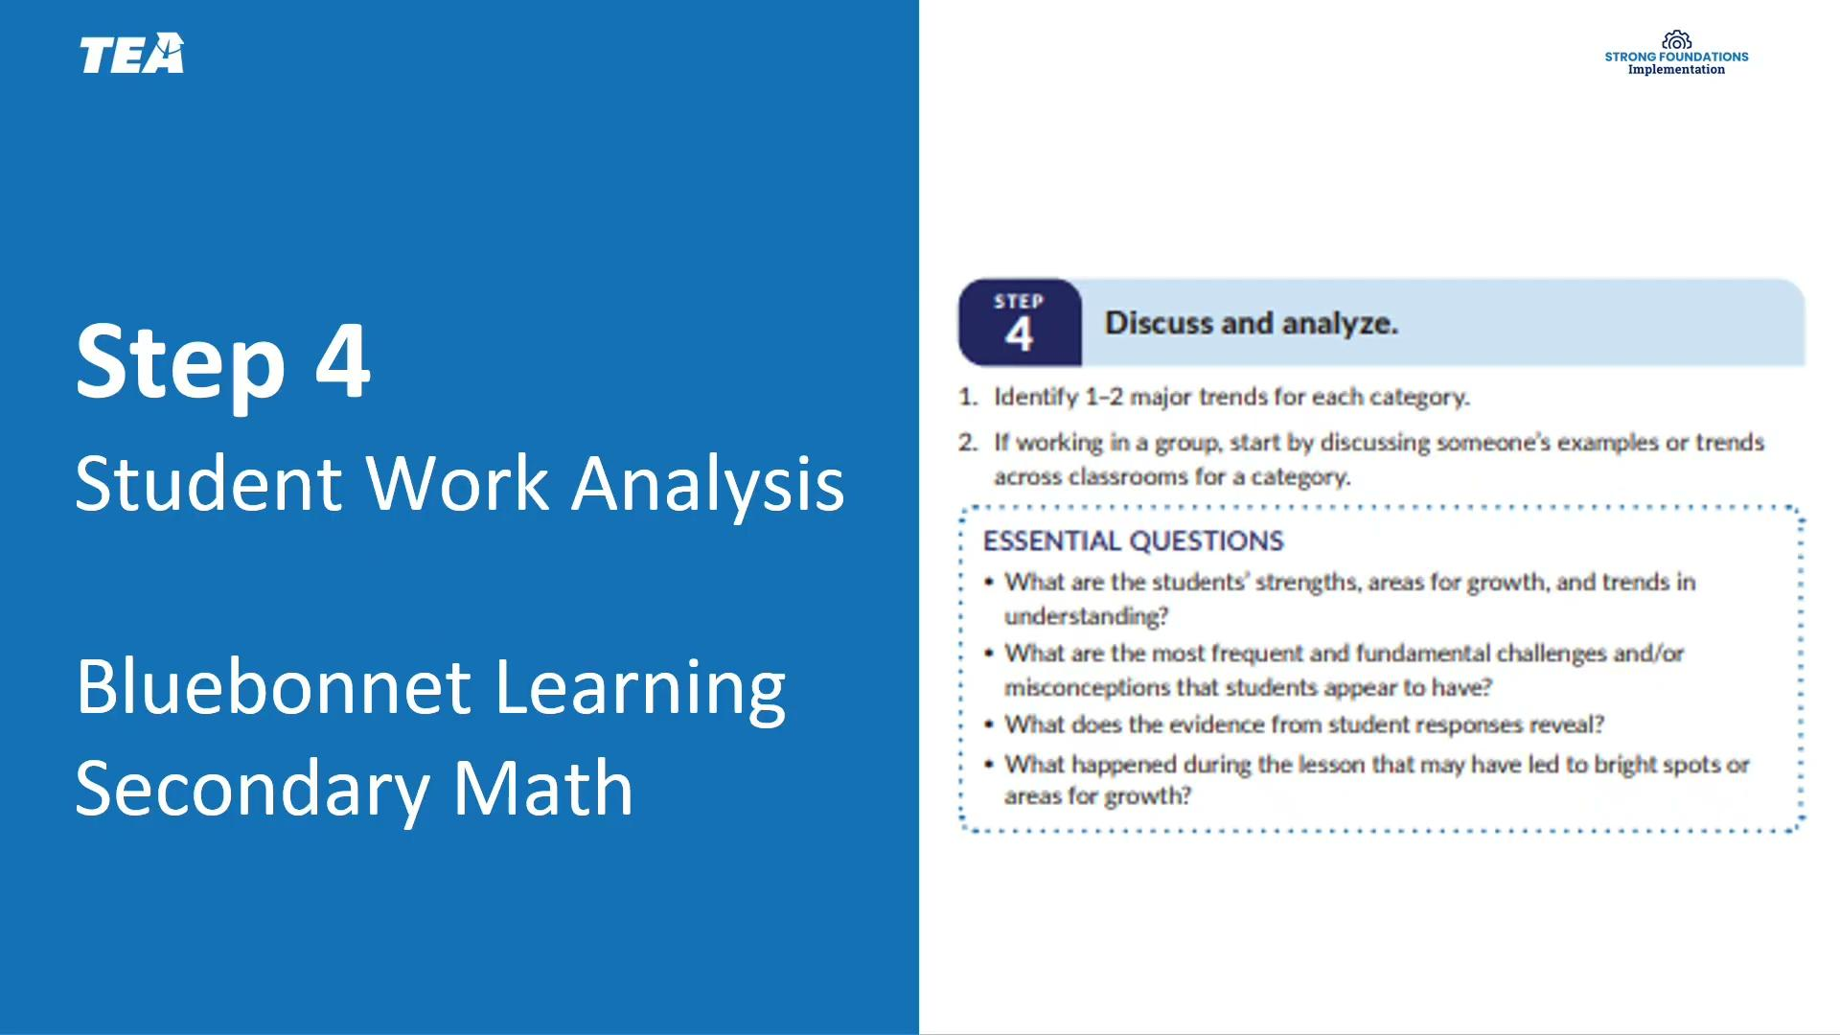
Exit Ticket #2: WRITE THIS DOWN Rationale: Step 4 is a key step of the protocol as it is the point at which teachers and coaches can really dive deep into the work and analyze it, looking for trends and considering instructional best practices that can lead to strong action steps in Step 5 (Determine action steps for whole group and
Exit ticket # 4 WRITE THIS DOWN Choice #3 meets all of our criteria for an effective action step. It is based on the data and uses only the HQIM. It also builds on the students’ strengths while maintaining grade-appropriate rigor.​
Notes:
Video for SWAP Step 4 Link:9. SFI_SY25-26_BLMathSecondary_CSWA_Video_SWAPStep4.mp4

Slide 20
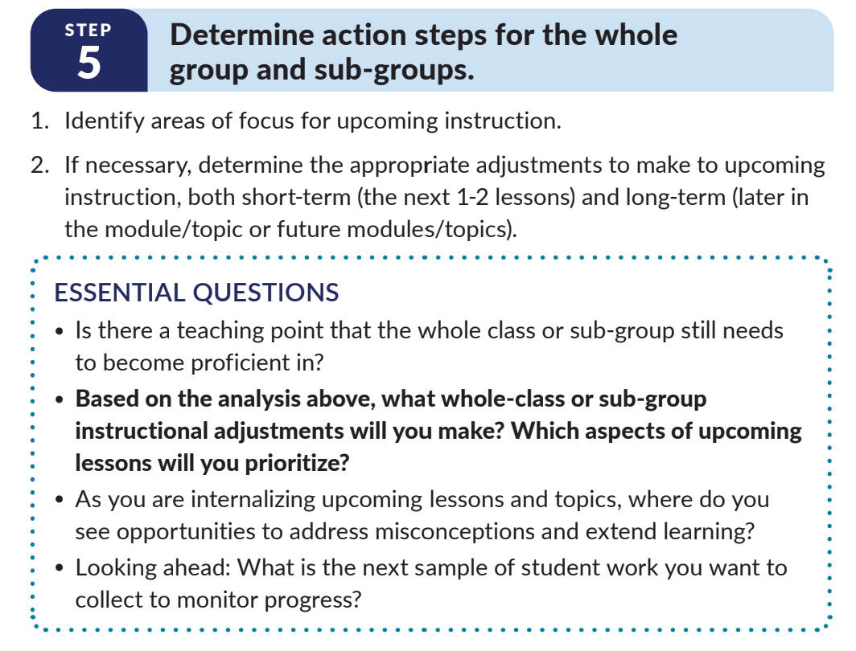
Step 5
  Targeted Skill: Determining action steps for whole group and sub-groups based on the data collected.
  Guiding Question:
How can you use the module and lesson internalization protocols to create strong action steps?
Notes:
:40-:45
Say: In this final step, teachers and coaches will use the data they have gathered and trends they have observed to create an action plan that targets specific adjustments to upcoming instruction. To honor our 60 minute session, we’re going to do a quick action step brainstorm then discussion how you can use the module and lesson internalization protocol to create strong actin steps. More with with Action Steps will occur in our Connecting Lesson Internalization with Student Work Analysis Session. Have participants work for 4 min then lead a 1 min discussion.

Slide 21
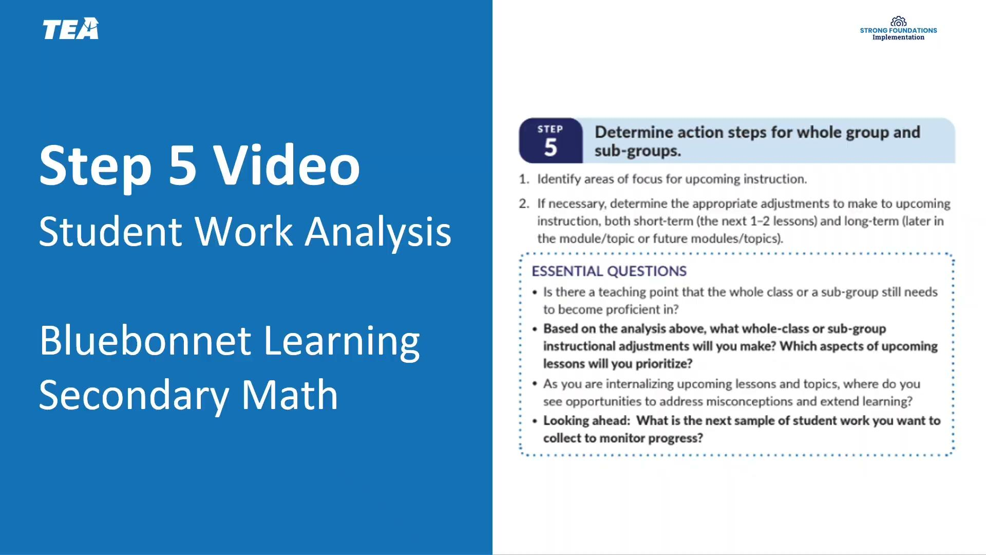
Exit Ticket #5 WRITE THIS DOWN Correct Answer Rationale: Providing each student with tailored feedback is time consuming and impacts pacing within Carnegie Learning Texas Math Solution 6 - 12. Step 4 is a good “big picture” area of focus because you would identify 1-2 major trends across the classroom for each category, which will then guide you to an instructional adjustment that targets the root misunderstanding.
Notes:
Video for SWAP Step 5 Link: 10. SFI_SY25-26_BLMathSecondary_CSWA_Video_SWAPStep5.mp4

Slide 22
Examples and Non-Examples of Action Steps
Action Step 1
The teacher decides to group Students who have fully mastered the concept and challenge them to complete the Stretch questions in the Assignment pages. ​​
This is a strong action step because based on student data, this action used the HQIM materials (all lessons have an assignment page and all assignment pages have a Stretch section) to allow students to further their understanding of the concept/skill they are working on.
Action Step 2
The teacher decides all students will complete the problems in the Skills Practice pages related to a concept in a lesson. ​
This is not a strong action step because the student data does not support the need for all students to complete the same work from the Skills Practice pages. The Skills Practice pages should be assigned as needed and not used as a general assignment for the whole group.​
Notes:
animated slide
:45-:47
Say: Let’s take a look at some examples of Action Steps based on data. After reading the action step, reflect on whether this is a strong action step or not a strong action step and provide a justification.
Facilitator notes: CLICK to reveal each description​.
​

Slide 23
Examples and Non-Examples of Action Steps
Action Step 3
The teacher works with students who did not demonstrate proficiency with the Talk the Talk task. The students use skills practice pages that practice the representational foundation of slope to then use the abstract calculations to find the slope of ordered pairs. ​
This is an example of a strong action step. The teacher should work with the students to identify their misconceptions or mistake and then allow them to work conceptually with the representations of slope and tables. Then students may move on to the calculations all receiving immediate feedback from the teacher.
Action Step 4
The teacher decides to teach a mini-lesson to the class using a 7th grade lesson introducing the concept of slope. ​
This is not a strong action step. Students should not be working on below grade level concepts. All students' time would be better spent working on the grade level concept connecting the slope formula and using a graph. This should be done without stopping to teach a lesson that is below grade level. ​
Notes:
animated slide
:47-:50
Facilitator notes: CLICK to reveal each description​

Slide 24
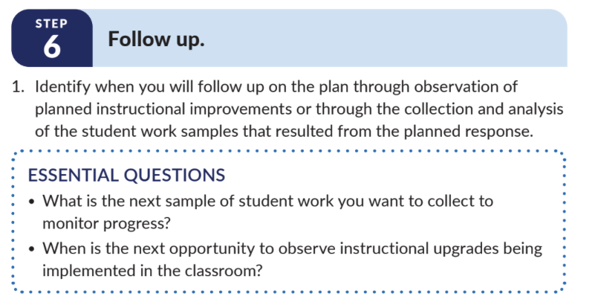
Step 6: Follow Up
In your Guided Notes reflect on the questions below:
What systems or structures do you have in place, or will you need to create, to follow up with teachers efficiently?
How will you share the “why” with your teachers regarding this follow-up stage so they clearly understand its purpose and have buy-in?
Notes:
50-:55
Say: The final step of the SWAP Coach Guide asks you to get clear about when and how you will follow up with the teachers you support. This helps to ensure that teachers hold themselves accountable by implementing the instructional improvements they have planned during student work analysis. In addition, this final step provides an opportunity to capture and celebrate success by noting how teachers’ data-driven instruction contributed to growth in student proficiency. This in turn makes it easier to carry out Step 0 (Reflect on past success) at the start of your next SWAP cycle. Optional, if time allows: We’re now going to reflect on the Follow up step in the Guided Notes. Take 3 min to stop and jot in your guided notes.
Note: If time, facilitator may lead a whole group or partner discussion regarding the guided question.

Slide 25
Agenda - Steps 4-6
Introduction
Student Work Analysis Protocol and Steps 1-3
Steps 4-6
Closing
Notes:
:55 min mark
Say: We are getting close to the end of the session. Let’s get reflect with our essential questions then take a look at next steps.

Slide 26
Synthesize Your Learning
Consider the importance of viewing student work and finding what the students CAN DO first, and answer the essential questions:
How will the implementation of the Student Work Analysis Protocol be similar to how you have responded to data in the past? How will it be different?
What are the benefits of using the Student Work Analysis Protocol in planning and supporting student learning?
Notes:
:55-:58
Say: There are a few questions I’d like you to consider as you synthesize your learning. read the 2 questions on the slide Take a few minutes to consider your own coaching practices in your school and reflect on the essential questions. You can jot your ideas down in your Guided Notes. Pause for 2 min for reflection. If time allows, ask for volunteers to share their reflections to one of the questions.

Slide 27
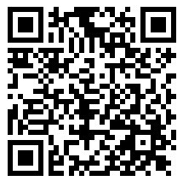
Complete the following tasks using your learning today:
  Exit Ticket
  Task 1
  Task 2
For general questions, please contact Name at email address.
Next Steps
Exit Ticket
Notes:
Notes:
Insert any important links in the slide. This can specific next steps, tasks, etc. If you have a facilitation survey, include that information as well.
Contact Information for session questions should be provided. Also share any other resources that may also be available like an FAQ, Office Hours, newsletters, etc.
If you know the next date and time of your next session(s) with this audience, please include those dates and times as well.
Exit Ticket Link: https://tea.co1.qualtrics.com/jfe/form/SV_1yJEDga0w9hPQ1g

Slide 28
Exit Ticket
Notes:
Exit Ticket
5-10 minutes
Link: https://tea.co1.qualtrics.com/jfe/form/SV_1yJEDga0w9hPQ1g
Note: You can choose to give participants 10 minutes to complete the exit ticket independently by adding to the guided notes or creating a separate document. The questions, answers, and rationale are included below in the slides just in case you want to review the exit ticket after giving it or use the questions to stamp key ideas at the end of the session. If you choose to review the questions, answers and rationale included in the slides with participants, please ensure the Exit Ticket link has been utilized first.

Slide 29
Exit Ticket​ Question 1
1. Which of the following BEST describes the impact of consistently using the Student Work Analysis Protocol?​
​Consistently using the SWAP will ensure that all key stakeholders are regularly looking at student work.​
Consistently using the SWAP will ensure that teachers have something to discuss with coaches in their collaborative meetings​
Consistently using the SWAP will ensure that students are receiving instruction that has been adjusted, based on data, to more intentionally meet their needs.​
Consistently using the SWAP will ensure that teachers are regularly and thoughtfully sorting student work to look for trends.​
​Correct Answer Rationale: While several of these answer choices are related to the SWAP, at least in part, the real impact is the impact on students who will be receiving instruction that accelerates their learning in a way that is specific to their strengths and areas of growth.
Notes:
Facilitator Note: Ideal time to review is 2 minutes per question. This gives time to name the question, right answer, and rationale for the correct answer. You can adjust timing as needed based on how you decide to administer the exit ticket or check for understanding. Remove green highlighting to show correct answer and correct answer rationale if you use as a live review rather than exit ticket.

Slide 30
Exit Ticket​ Question 2
2. Which of the following BEST describes the purpose of Step 4 of the SWAP?​
​Step 4 allows teachers and coaches to build a deeper understanding of the task at hand and what is being assessed in it.​
Step 4 creates a space for teachers and coaches to plan ahead to the next week’s lessons in order to spiral in necessary skills and determine smaller groupings for reteaches.​
Step 4 provides teachers and coaches with an opportunity to anticipate and plan for student misconceptions.​
Step 4 encourages teachers and coaches to not only think critically about the trends they are seeing in student work, but to consider the task and the classroom more holistically in order to better understand what needs to be addressed.​
​Correct Answer Rationale: Step 4 is a key step of the protocol as it is the point at which teachers and coaches can really dive deep into the work and analyze it, looking for trends and considering instructional best practices that can lead to strong action steps in Step 5 (Determine action steps for whole group and sub-groups).
Notes:
Facilitator Note: Ideal time to review is 2 minutes per question. This gives time to name the question, right answer, and rationale for the correct answer. You can adjust timing as needed based on how you decide to administer the exit ticket or check for understanding. Remove green highlighting to show correct answer and correct answer rationale if you use as a live review rather than exit ticket.

Slide 31
Exit Ticket​ Question 3
3. Prior to a student work analysis meeting, you ask a teacher you coach to complete Steps 1 and 2 on their own. The task you will be analyzing is a formative assessment that involves explaining the connection between finding the slope from a table and from a graph. They present the following success criteria. Based on what you have learned in this session, which of the options below is NOT a strong example of success criteria?​
The student used all of the time available to them for this assignment.​
The student uses the slope formula with 2 points on the table and explains the connection to the coordinates of the points on the graph.​
The student shows how the slope triangle is related to finding the differences in x's and y's used in the slope formula.​
The student uses the points in the table and on the graph to explain their thinking visually and arithmetically to connect the rise over run on the graph to the difference in y over the difference in x in the formula.​
Correct Answer Rationale: Strong success criteria 1) are observable in the student’s response, 2) List the qualities that must be present in the response, 3) Use student—friendly language, and 4) Align to the objective. Choice 1 is not observable as there is no way to know from the work sample alone how much time was spent on the task.​
Notes:
Facilitator Note: Ideal time to review is 2 minutes per question. This gives time to name the question, right answer, and rationale for the correct answer. You can adjust timing as needed based on how you decide to administer the exit ticket or check for understanding. Remove green highlighting to show correct answer and correct answer rationale if you use as a live review rather than exit ticket.

Slide 32
Exit Ticket​ Question 4
4. You have just completed the first four steps of the SWAP with one of your teachers. The data shows that students are doing very well finding the slope of a line on a graph, but are struggling with finding the slope between points found in a table. Which of the following would be the MOST effective action step to recommend?​
Find an upcoming lesson that includes a scenario represented with a table and before it comes up, have the teacher create an activity where students rewrite the points in the table as coordinates.​
Find an upcoming lesson where students find the slope using the slope formula and make a plan to celebrate how well the class is doing with that skill.​
Find an upcoming lesson that discusses linear relationships in a table and build in several additional scaffolding questions to ask students, including one that connects the points in the table to coordinates on a graph, to help students better access the connection between the differences between x and y values in the table and the rise over run they are comfortable with on the graph. ​
Find an upcoming lesson where students will be finding the slope between points in a table and print out copies of an anchor chart from an outside source to share with students.​
Correct Answer Rationale: Choice #3 meets all of our criteria for an effective action step. It is based on the data and uses only the HQIM. It also builds on the students’ strengths while maintaining grade-appropriate rigor.​
Notes:
Facilitator Note: Ideal time to review is 2 minutes per question. This gives time to name the question, right answer, and rationale for the correct answer. You can adjust timing as needed based on how you decide to administer the exit ticket or check for understanding. Remove green highlighting to show correct answer and correct answer rationale if you use as a live review rather than exit ticket.

Slide 33
Exit Ticket​ Question 5
5. You recently completed the SWAP for the first time. After completing step 5, the next day you implement the following action step: You shorten the lesson to 30 minutes so you can individually conference with each student to discuss the previous day's Talk the Talk. After reflecting on your first SWAP implementation, you realize that this action step was very time consuming, and you missed important whole group content. You decide that the following step would be a beneficial area of focus going forward:​
Step 1; you need to better understand the standards​
Step 3; you need to identify what the students can do and what they cannot do yet​
Step 4; you could better identify the major trends across the classroom​
None of them; you’ve achieved mastery after the first try​
Correct Answer Rationale: Providing each student with tailored feedback is time consuming and impacts pacing within Carnegie Learning Texas Math Solution 6 - 12. Step 4 is a good “big picture” area of focus because you would identify 1-2 major trends across the classroom for each category, which will then guide you to an instructional adjustment that targets the root misunderstanding.
Notes:
Facilitator Note: Ideal time to review is 2 minutes per question. This gives time to name the question, right answer, and rationale for the correct answer. You can adjust timing as needed based on how you decide to administer the exit ticket or check for understanding. Remove green highlighting to show correct answer and correct answer rationale if you use as a live review rather than exit ticket.

